Slide 1

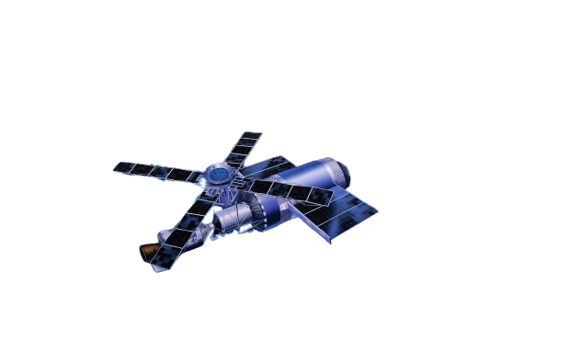

Developing a Web-Based Application for Ground-Based and Landsat Data Comparison
Facilitating Experiential Learning with Earth Observation
Team name: PIXEL PIONEER
Team leader: Prince Shah
Team member’s: Satyam Mishra , Animesh Anand,
Anubhaw Pratap Singh, Jagjeet Singh, Amit raj

Slide 2
The Importance of Landsat Missions
• Landsat provides the longest continuous dataset of Earth’s land surface.
• Vital for understanding changes in the environment, land use, and natural resources.

Slide 3
Why Compare Ground-Based and Landsat Data?
• Facilitates experiential learning with real-world data.
• Encourages scientific exploration and interdisciplinary thinking.
• Fosters spatial awareness and skills.
• Empowers individuals to become informed global citizens.

Slide 4
Challenges of Comparing Ground-Based Measurements with Landsat Data
• Ground-based spectral measurements are often made in isolation.
• To compare with Landsat Surface Reflectance (SR) data, you need:
- To know when Landsat passes over a specific area.
- To access Landsat data collected at that place and time.

Slide 5
Core Functionalities
1. Location Input: Users define a specific geographic location.
2. Notification System: Alerts users when Landsat will pass over the target area.
3. Data Access: Enables users to access relevant Landsat SR data for the defined location and time.

Slide 6
Empowering Scientific Exploration
• Researchers: Easier access to satellite data for analysis.
• Educators and Students: Engage in real-world data-driven learning.
• Citizens: Understand environmental changes and trends in their own regions.

Slide 7
A Tool for the Future
• This application supports scientific learning, exploration, and awareness.
• Helps users to easily compare ground-based and satellite data.
• Provides a pathway for more informed environmental decisions.

